Slide 1
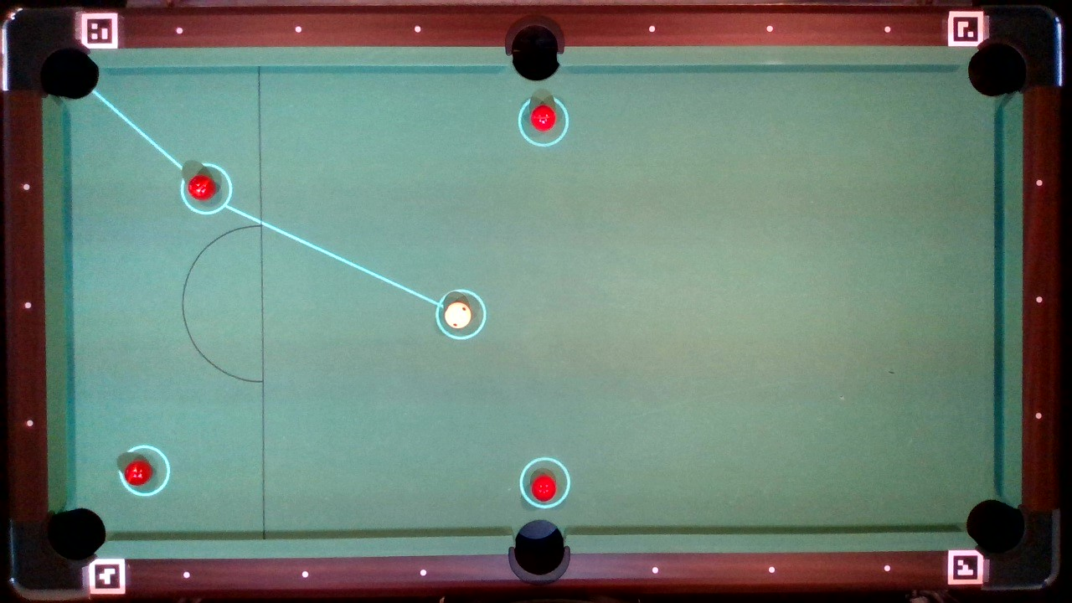
30cm
51cm

Slide 2
0°
15°

Slide 3
Strength

